Slide 1
ECEG-5193: Algorithm Analysis and Design
Analysis of Sorting and Searching algorithms
Linear time Sorting

Slide 2
Sorting in Linear Time

Slide 3
How Fast Can We Sort?

Slide 4
How Fast Can We Sort?
Insertion sort: O(n²)
Bubble Sort, Selection Sort:
Merge sort:
Quicksort:
Heap sort
What is common to all these algorithms?
These algorithms sort by making comparisons between the input elements
Θ(n²)
Θ(nlgn)
Θ(nlgn) - average
Θ(nlgn)

Slide 5
Lower-Bound for Sorting
Theorem:
To sort n elements, comparison sorts must make Ω(nlgn) comparisons in the worst case.

Slide 6
Counting Sort
Assumptions:
Sort n integers which are in the range [0 ... r]
r is in the order of n, that is, r=O(n)
Idea:
For each element x, find the number of elements ≤ x
Place x into its correct position in the output array
output array

Slide 7
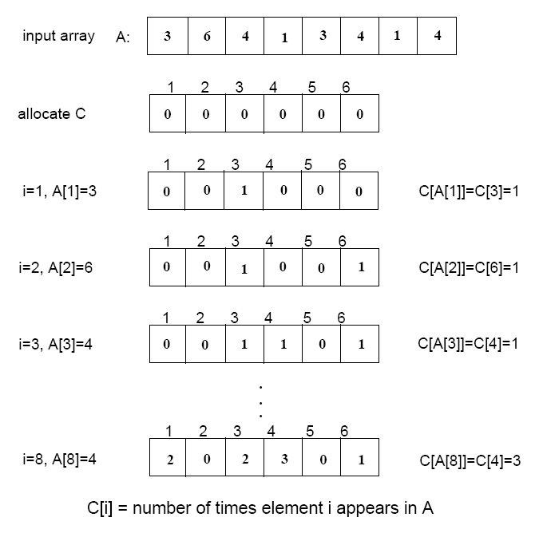
Example
Counting Sort

Slide 8

Step 1
(i.e., frequencies)

Slide 9
Step 1

Slide 10
Step 1
Input
3
6
4
1
3
4
1
4
C
0
0
0
0
0
0
1
2
3
4
5
6

Slide 11
Step 1
Input
3
6
4
1
3
4
1
4
C
0
1
0
0
0
0
0
1
2
3
4
5
6

Slide 12
Step 1
Input
3
6
6
4
1
3
4
1
4
C
0
0
1
0
1
0
0
1
2
3
4
5
6

Slide 13
Step 1
Input
3
6
4
1
3
4
1
4
4
C
0
1
0
1
0
1
0
1
2
3
4
5
6

Slide 14
Step 1
Input
3
6
4
1
3
4
1
4
1
C
1
0
0
1
1
0
1
1
2
3
4
5
6

Slide 15
Step 1
Input
3
6
4
1
3
4
1
4
3
C
1
1
1
0
1
0
1
1
2
3
4
5
6

Slide 16
Step 1
Input
3
6
4
4
4
1
3
4
1
C
1
2
0
1
0
2
1
1
2
3
4
5
6

Slide 17
Step 1
Input
3
6
4
1
4
4
1
3
1
C
1
2
0
2
2
0
1
1
2
3
4
5
6

Slide 18
Step 1
Input
3
6
4
4
1
3
4
1
4
C
2
3
0
1
0
2
2
1
2
3
4
5
6

Slide 19
Step 1
Input
3
6
4
1
3
4
1
4
C
2
0
2
3
0
1
1
2
3
4
5
6

Slide 20
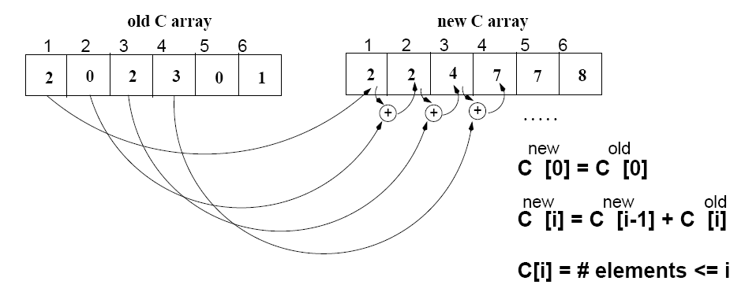
Step 2
(i.e., cumulative sums)

Slide 21
Step 2
1
2
3
4
5
6
Old C
2
0
2
3
0
1
New C
2
0
0
0
0
0
0
0
1
2
3
4
5
6

Slide 22
Step 2
1
2
3
4
5
6
Old C
2
0
2
3
0
1
+
New C
2
2
0
0
0
0
0
1
2
3
4
5
6

Slide 23
Step 2
1
2
3
4
5
6
Old C
2
0
2
3
0
1
+
New C
2
2
0
0
0
0
4
1
2
3
4
5
6

Slide 24
Step 2
1
2
3
4
5
6
Old C
2
0
2
3
0
1
+
New C
2
7
0
0
2
4
0
1
2
3
4
5
6

Slide 25
Step 2
1
2
3
4
5
6
Old C
2
0
2
3
0
1
+
New C
2
7
2
4
7
0
0
1
2
3
4
5
6

Slide 26
Step 2
1
2
3
4
5
6
Old C
2
0
2
3
0
1
+
New C
2
7
8
2
4
7
0
1
2
3
4
5
6

Slide 27
Step 3
Place A[i] at its correct place
Start from the last element of A.
Place A[i] at its correct place in the output array
Decrease C[A[i]] by one
Input
3
6
4
1
3
4
1
4
1
2
3
4
5
6
C
2
2
4
7
7
8
Output
1
2
3
4
5
6
7
8

Slide 28
Step 3
Place A[i] at its correct place
Start from the last element of A.
Place A[i] at its correct place in the output array
Decrease C[A[i]] by one
Input
3
6
4
1
3
4
1
4
1
2
3
4
5
6
C
2
6
7
8
2
4
7
Output
4
1
2
3
4
5
6
7
8

Slide 29
Step 3
Place A[i] at its correct place
Start from the last element of A.
Place A[i] at its correct place in the output array
Decrease C[A[i]] by one
Input
3
6
4
1
3
4
1
4
1
2
3
4
5
6
1
C
2
2
4
6
7
8
Output
1
4
1
2
3
4
5
6
7
8

Slide 30
Step 3
Place A[i] at its correct place
Start from the last element of A.
Place A[i] at its correct place in the output array
Decrease C[A[i]] by one
Input
3
6
4
1
3
4
1
4
1
2
3
4
5
6
C
1
5
7
8
2
4
6
Output
1
4
4
1
2
3
4
5
6
7
8

Slide 31
Step 3
Place A[i] at its correct place
Start from the last element of A.
Place A[i] at its correct place in the output array
Decrease C[A[i]] by one
Input
3
6
4
1
3
4
1
4
1
2
3
4
5
6
C
1
3
5
7
8
2
4
Output
1
3
4
4
1
2
3
4
5
6
7
8

Slide 32
Step 3
Place A[i] at its correct place
Start from the last element of A.
Place A[i] at its correct place in the output array
Decrease C[A[i]] by one
Input
3
6
4
1
3
4
1
4
1
2
3
4
5
6
0
C
1
2
3
5
7
8
Output
1
1
3
4
4
1
2
3
4
5
6
7
8

Slide 33
Step 3
Place A[i] at its correct place
Start from the last element of A.
Place A[i] at its correct place in the output array
Decrease C[A[i]] by one
Input
3
6
4
1
3
4
1
4
1
2
3
4
5
6
C
0
4
7
8
2
3
5
Output
1
1
3
4
4
4
1
2
3
4
5
6
7
8

Slide 34
Step 3
Place A[i] at its correct place
Start from the last element of A.
Place A[i] at its correct place in the output array
Decrease C[A[i]] by one
Input
3
6
4
1
3
4
1
4
1
2
3
4
5
6
C
0
7
7
2
3
3
8
Output
1
1
3
4
4
4
6
1
2
3
4
5
6
7
8

Slide 35
Step 3
Place A[i] at its correct place
Start from the last element of A.
Place A[i] at its correct place in the output array
Decrease C[A[i]] by one
Input
3
6
4
1
3
4
1
4
1
2
3
4
5
6
C
0
2
3
7
8
2
3
Output
1
1
3
3
4
4
4
6
1
2
3
4
5
6
7
8

Slide 36
Example -2
1
2
3
4
5
6
7
8
0
1
2
3
4
5
A
2
5
3
0
2
3
0
3
C
2
2
4
7
7
8
0
1
2
3
4
5
(cumulative sums)
C
2
0
2
3
0
1
(frequencies)
1
2
3
4
5
6
7
8
1
2
3
4
5
6
7
8
B
3
B
0
3
0
1
2
3
4
5
0
1
2
3
4
5
C
2
2
4
6
7
8
C
1
2
4
6
7
8
1
2
3
4
5
6
7
8
1
2
3
4
5
6
7
8
B
0
3
3
B
0
2
3
3
0
1
2
3
4
5
0
1
2
3
4
5
C
1
2
4
5
7
8
C
1
2
3
5
7
8

Slide 37
Example (cont.)
1
2
3
4
5
6
7
8
A
2
5
3
0
2
3
0
3
1
2
3
4
5
6
7
8
1
2
3
4
5
6
7
8
B
0
0
2
3
3
B
0
0
2
3
3
3
5
0
1
2
3
4
5
0
1
2
3
4
5
C
0
2
3
5
7
8
C
0
2
3
4
7
7
1
2
3
4
5
6
7
8
1
2
3
4
5
6
7
8
B
0
0
2
3
3
3
B
0
0
2
2
3
3
3
5
0
1
2
3
4
5
C
0
2
3
4
7
8

Slide 38
COUNTING-SORT
1
j
n
A
COUNTING-SORT(A, B, n, k)
for i ← 0 to r
do C[ i ] ← 0
for j ← 1 to n
do C[A[ j ]] ← C[A[ j ]] + 1
C[i] contains the number of elements equal to i
for i ← 1 to r
do C[ i ] ← C[ i ] + C[i -1]
C[i] contains the number of elements ≤ i
for j ← n downto 1
do B[C[A[ j ]]] ← A[ j ]
C[A[ j ]] ← C[A[ j ]] - 1
0
k
C
1
n
B

Slide 39
Analysis of Counting Sort
COUNTING-SORT(A, B, n, k)
for i ← 0 to r
do C[ i ] ← 0
for j ← 1 to n
do C[A[ j ]] ← C[A[ j ]] + 1
C[i] contains the number of elements equal to i
for i ← 1 to r
do C[ i ] ← C[ i ] + C[i -1]
C[i] contains the number of elements ≤ i
for j ← n downto 1
do B[C[A[ j ]]] ← A[ j ]
C[A[ j ]] ← C[A[ j ]] - 1
Θ(r)
Θ(n)
Θ(r)
Θ(n)
Overall time: Θ(n + r)

Slide 40
Analysis of Counting Sort
Overall time: Θ(n + r)
In practice we use COUNTING sort when r = O(n)
⇒ running time is Θ(n)
Counting sort is stable
Counting sort is not in place sort

Slide 41

Radix Sort
Assumptions
d=Θ(1) and k =O(n)
Sorting looks at one column at a time
For a d digit number, sort the least significant digit first
Continue sorting on the next least significant digit, until all digits have been sorted
Requires only d passes through the list

Slide 42

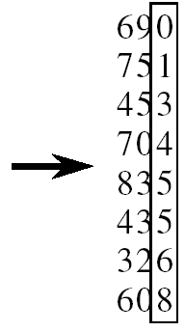
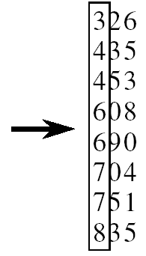
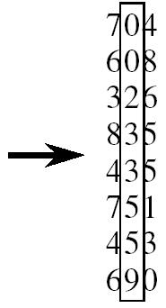
RADIX-SORT
RADIX-SORT(A, d)
for i ← 1 to d
do use a stable sort to sort
array A on
digit i
1 is the lowest order digit, d is the highest-order digit

Slide 43
Analysis of Radix Sort
Given n numbers of d digits each, where each digit may take up to k possible values, RADIX-SORT correctly sorts the numbers in Θ(d(n+k))
One pass of sorting per digit takes Θ(n+k) assuming that we use counting sort
There are d passes (for each digit)

Slide 44
Correctness of Radix sort
We use induction on number of passes through each digit
Basis: If d = 1, there’s only one digit, trivial
Inductive step: assume digits 1, 2, . . . , d-1 are sorted
Now sort on the d-th digit
If a_{d} < b_{d}, sort will put a before b: correct
a < b regardless of the low-order digits
If a_{d} > b_{d}, sort will put a after b: correct
a > b regardless of the low-order digits
If a_{d} = b_{d}, sort will leave a and b in the
same order (stable!) and a and b are
already sorted on the low-order d-1 digits

Slide 45
Bucket Sort
Assumption:
the input is generated by a random process that distributes elements uniformly over [0, 1)
Idea:
Divide [0, 1) into n equal-sized buckets
Distribute the n input values into the buckets
Sort each bucket (e.g., using quicksort)
Go through the buckets in order, listing elements in each one
Input: A[1 . . n], where 0 ≤ A[i] < 1 for all i
Output: elements A[i] sorted
Auxiliary array: B[0 . . n - 1] of linked lists, each list initially empty

Slide 46
Example - Bucket Sort
A
1
.78
.17
.39
.26
.72
.94
.21
.12
.23
.68
B
0
/
2
1
.17
.12 /
3
2
.26
.21
.23 /
4
3
.39 /
5
4
/
6
5
/
7
6
.68 /
8
7
.78
.72 /
9
8
/
10
9
.94 /

Slide 47
Example - Bucket Sort
.12
.17
.21
.23
.26
.39
.68
.72
.78
.94 /
0
/
1
.12
.17 /
2
.21
.23
.26 /
3
.39 /
4
/
5
/
6
.68 /
7
.72
.78 /
Concatenate the lists from
0 to n – 1 together, in order
8
/
9
.94 /

Slide 48
Correctness of Bucket Sort
Consider two elements A[i], A[ j]
Assume without loss of generality that A[i] ≤ A[j]
Then ⎣nA[i]⎦ ≤ ⎣nA[j]⎦
A[i] belongs to the same bucket as A[j] or to a bucket with a lower index than that of A[j]
If A[i], A[j] belong to the same bucket:
sorting puts them in the proper order
If A[i], A[j] are put in different buckets:
concatenation of the lists puts them in the proper order

Slide 49
Analysis of Bucket Sort
BUCKET-SORT(A, n)
for i ← 1 to n
do insert A[i] into list B[⎣nA[i]⎦]
for i ← 0 to n - 1
do sort list B[i] with quicksort sort
concatenate lists B[0], B[1], . . . , B[n -1] together in order
return the concatenated lists
O(n)
Θ(n)
O(n)
Θ(n)

Slide 50
Conclusion
Any comparison sort will take at least nlgn to sort an array of n numbers
We can achieve a better running time for sorting if we can make certain assumptions on the input data:
In some situation (like above) we can sort in Θ(n)
counting sort
radix sort
bucket sort
Leverage additional knowledge about the data besides comparisons

Slide 51
Why don’t we hear about these more?
Constants can be large and running times therefore may be larger for modest input sizes
Cache friendliness
Memory (Quicksort sorts in place)
Hardware considerations

Slide 52
Radix Sort Is a Bucket Sort

Slide 53
Running Time of 2nd Step

Slide 54
Radix Sort as a Bucket Sort

Slide 55
Effect of radix k
4

Slide 56
Problems
You are given 5 distinct numbers to sort. Describe an algorithm which sorts them using at most 6 comparisons, or argue that no such algorithm exists.

Slide 57
Problems
Show how you can sort n integers in the range 1 to n² in O(n) time.

Slide 58
Non-comparison Sorts: Counting Sort
Depends on a key assumption: numbers to be sorted are integers in {0, 1, 2, …, k}.
Input: A[1..n] , where A[j] ∈ {0, 1, 2, …, k} for j = 1, 2, …, n. Array A and values n and k are given as parameters.
Output: B[1..n] sorted. B is assumed to be already allocated and is given as a parameter.
Auxiliary Storage: C[0..k]
Runs in linear time if k = O(n).

Slide 59
Counting-Sort
CountingSort(A, B, k)
1. for i ← 1 to k
2. do C[i] ← 0
3. for j ← 1 to length[A]
4. do C[A[j]] ← C[A[j]] + 1
5. for i ← 2 to k
6. do C[i] ← C[i] + C[i –1]
7. for j ← length[A] downto 1
8. do B[C[A[j]]] ← A[j]
9. C[A[j]] ← C[A[j]]–1
O(k)
O(n)
O(k)
O(n)

Slide 60
Algorithm Analysis
The overall time is O(n+k). When we have k=O(n), the worst case is O(n).
for-loop of lines 1-2 takes time O(k)
for-loop of lines 3-4 takes time O(n)
for-loop of lines 5-6 takes time O(k)
for-loop of lines 7-9 takes time O(n)
Stable, but not in place.
No comparisons made: it uses actual values of the elements to index into an array.

Slide 61
What values of k are practical?
Good for sorting 32-bit values? No. Why?
16-bit? Probably not.
8-bit? Maybe, depending on n.
4-bit? Probably, (unless n is really small).
Counting sort will be used in radix sort.

Slide 62
Radix Sort
It was used by the card-sorting machines.
Card sorters worked on one column at a time.
It is the algorithm for using the machine that extends the technique to multi-column sorting.
The human operator was part of the algorithm!
Key idea: sort on the “least significant digit” first and on the remaining digits in sequential order. The sorting method used to sort each digit must be “stable”.
If we start with the “most significant digit”, we’ll need extra storage.

Slide 63
An Example
Input
After sorting
on LSD
After sorting
on middle
digit
After sorting
on MSD
392 631 928 356
356 392 631 392
446 532 532 446
928 ⇒ 495 ⇒ 446 ⇒ 495
631 356 356 532
532 446 392 631
495 928 495 928
↑ ↑ ↑

Slide 64
Radix-Sort(A, d)
RadixSort(A, d)
1. for i ← 1 to d
2. do use a stable sort to sort array A on digit i
Correctness of Radix Sort
By induction on the number of digits sorted.
Assume that radix sort works for d – 1 digits.
Show that it works for d digits.
Radix sort of d digits ≡ radix sort of the low-order d – 1 digits followed by a sort on digit d .

Slide 65
Correctness of Radix Sort
By induction hypothesis, the sort of the low-order d – 1 digits works, so just before the sort on digit d , the elements are in order according to their low-order d – 1 digits. The sort on digit d will order the elements by their d^{th} digit.
Consider two elements, a and b, with d^{th} digits a_{d} and b_{d}:
If a_{d} < b_{d} , the sort will place a before b, since a < b regardless of the low-order digits.
If a_{d} > b_{d} , the sort will place a after b, since a > b regardless of the low-order digits.
If a_{d} = b_{d} , the sort will leave a and b in the same order, since the sort is stable. But that order is already correct, since the correct order of is determined by the low-order digits when their d^{th} digits are equal.

Slide 66
Algorithm Analysis
Each pass over n d-digit numbers then takes time Θ(n+k). (Assuming counting sort is used for each pass.)
There are d passes, so the total time for radix sort is Θ(d (n+k)).
When d is a constant and k = O(n), radix sort runs in linear time.
Radix sort, if uses counting sort as the intermediate stable sort, does not sort in place.
If primary memory storage is an issue, quicksort or other sorting methods may be preferable.

Slide 67
Bucket Sort
Assumes input is generated by a random process that distributes the elements uniformly over [0, 1).
Idea:
Divide [0, 1) into n equal-sized buckets.
Distribute the n input values into the buckets.
Sort each bucket.
Then go through the buckets in order, listing elements in each one.

Slide 68
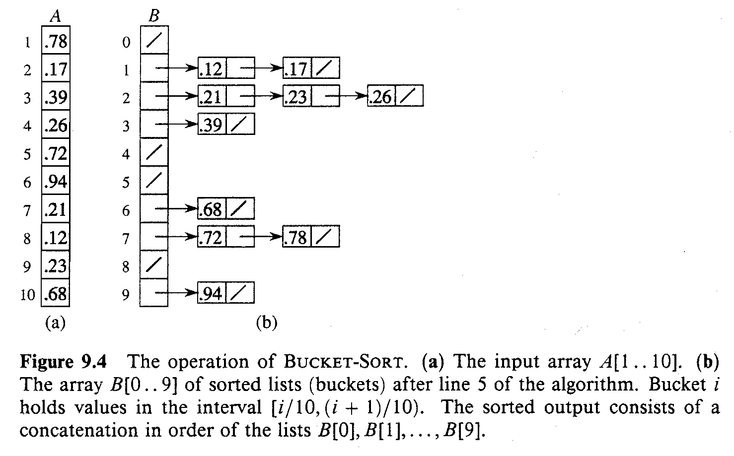
An Example

Slide 69
Bucket-Sort (A)
Input: A[1..n], where 0 ≤ A[i] < 1 for all i.
Auxiliary array: B[0..n – 1] of linked lists, each list initially empty.
BucketSort(A)
1. n ← length[A]
2. for i ← 1 to n
3. do insert A[i] into list B[ ⎣nA[i]⎦ ]
4. for i ← 0 to n – 1
5. do sort list B[i] with insertion sort
concatenate the lists B[i]s together in order
return the concatenated lists

Slide 70
Correctness of BucketSort
Consider A[i], A[j]. Assume w.o.l.o.g, A[i] ≤ A[j].
Then, ⎣n × A[i]⎦ ≤ ⎣n × A[j]⎦.
So, A[i] is placed into the same bucket as A[j] or into a bucket with a lower index.
If same bucket, insertion sort fixes up.
If earlier bucket, concatenation of lists fixes up.

Slide 71
Analysis
Relies on no bucket getting too many values.
All lines except insertion sorting in line 5 take O(n) altogether.
Intuitively, if each bucket gets a constant number of elements, it takes O(1) time to sort each bucket ⇒ O(n) sort time for all buckets.
We “expect” each bucket to have few elements, since the average is 1 element per bucket.
But we need to do a careful analysis.

Slide 72
Analysis – Contd.
RV n_{i} = no. of elements placed in bucket B[i].
Insertion sort runs in quadratic time. Hence, time for bucket sort is:
(8.1)

Slide 73
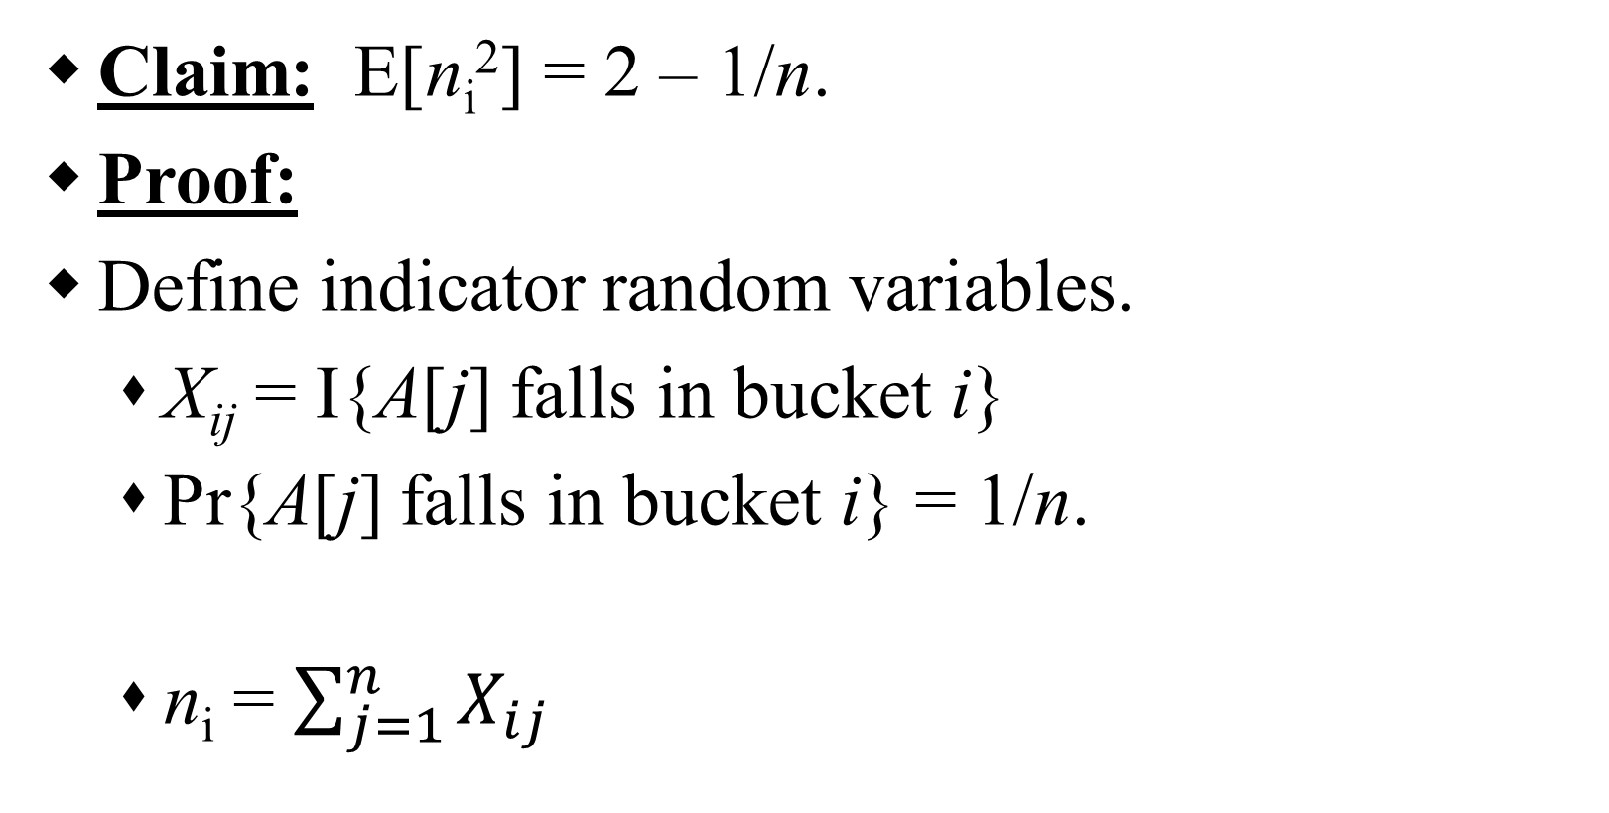
Analysis – Contd.
(8.2)
Claim: E[n_{i}²] = 2 – 1/n.
Proof:
Define indicator random variables.
X_{ij} = I{A[j] falls in bucket i}
Pr{A[j] falls in bucket i} = 1/n.
n_{i} = $\sum_{j=1}^{n}{X_{ij}}$

Slide 74
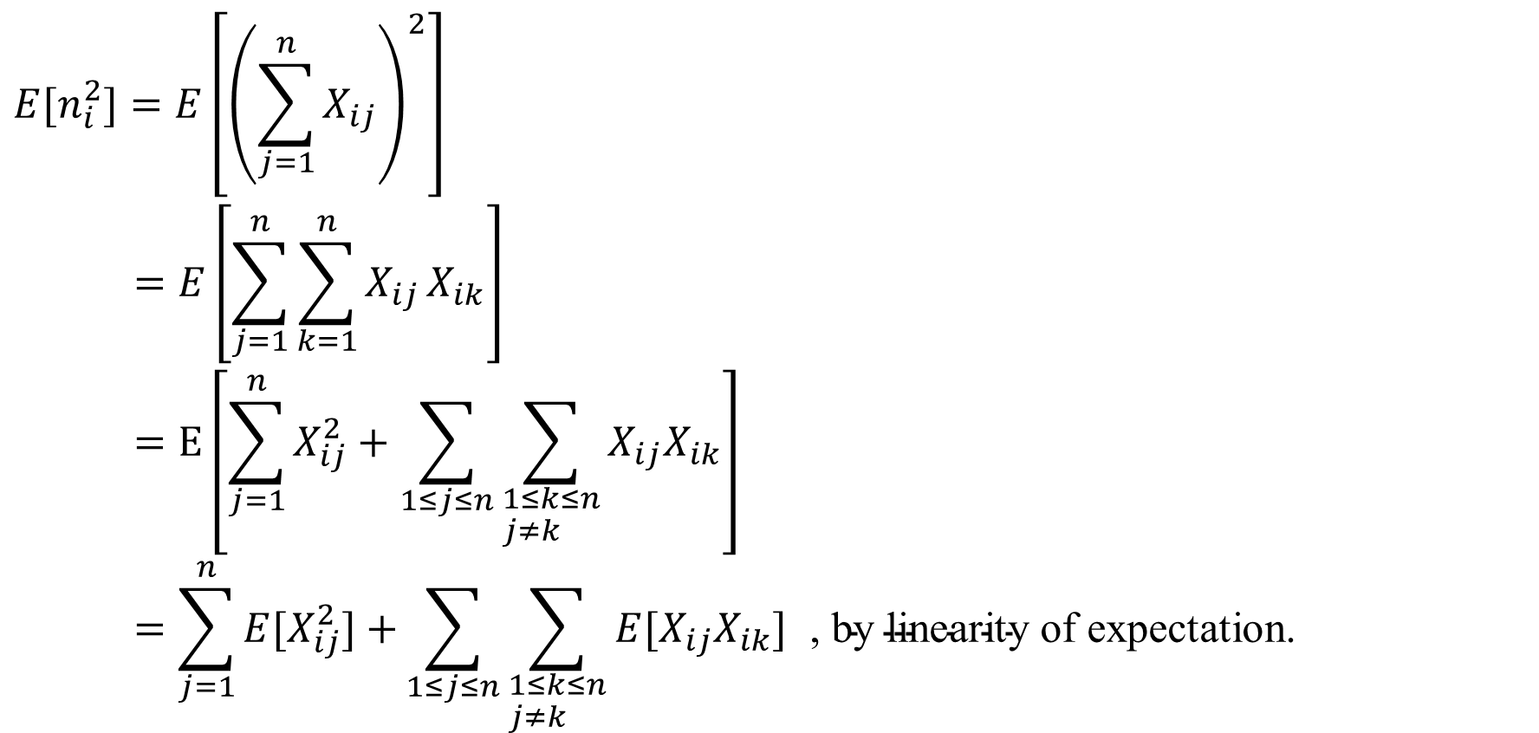
Analysis – Contd.
$$E[n_{i}^{2}]=E\left[{\left(\sum_{j=1}^{n}{X_{ij}}\right)}^{2}\right] \\ =E\left[\sum_{j=1}^{n}{\sum_{k=1}^{n}{X_{ij}}}X_{ik}\right] \\ =E\left[\sum_{j=1}^{n}{X_{ij}^{2}+\sum_{1≤j≤n}{\sum_{\begin{aligned}&1≤k≤n \\ &j≠k\end{aligned}}{X_{ij}X_{ik}}}}\right] \\ =\sum_{j=1}^{n}{E[X_{ij}^{2}]+}\sum_{1≤j≤n}{\sum_{\begin{aligned}&1≤k≤n \\ &j≠k\end{aligned}}{E[X_{ij}X_{ik}]\text{ ,} \text{by} \text{linearity} \text{of} \text{expectation}\text{.}}}$$
(8.3)

Slide 75
Analysis – Contd.

Slide 76
Analysis – Contd.
(8.3) is hence,
Substituting (8.2) in (8.1), we have,

Slide 77
Review: Comparison Sorts
Comparison sorts: O(n lg n) at best
Model sort with decision tree
Path down tree = execution trace of algorithm
Leaves of tree = possible permutations of input
Tree must have n! leaves, so O(n lg n) height

Slide 78
Review: Counting Sort
Counting sort:
Assumption: input is in the range 1..k
Basic idea:
Count number of elements k ≤ each element i
Use that number to place i in position k of sorted array
No comparisons! Runs in time O(n + k)
Stable sort
Does not sort in place:
O(n) array to hold sorted output
O(k) array for scratch storage

Slide 79
Review: Counting Sort
1 CountingSort(A, B, k)
2 for i=1 to k
3 C[i]= 0;
4 for j=1 to n
5 C[A[j]] += 1;
6 for i=2 to k
7 C[i] = C[i] + C[i-1];
8 for j=n downto 1
9 B[C[A[j]]] = A[j];
10 C[A[j]] -= 1;

Slide 80
Review: Radix Sort
How did IBM get rich originally?
Answer: punched card readers for census tabulation in early 1900’s.
In particular, a card sorter that could sort cards into different bins
Each column can be punched in 12 places
Decimal digits use 10 places
Problem: only one column can be sorted on at a time

Slide 81
Review: Radix Sort
Intuitively, you might sort on the most significant digit, then the second msd, etc.
Problem: lots of intermediate piles of cards (read: scratch arrays) to keep track of
Key idea: sort the least significant digit first
RadixSort(A, d)
for i=1 to d
StableSort(A) on digit i
Example: Fig 9.3

Slide 82
Radix Sort
Can we prove it will work?
Sketch of an inductive argument (induction on the number of passes):
Assume lower-order digits {j: j<i}are sorted
Show that sorting next digit i leaves array correctly sorted
If two digits at position i are different, ordering numbers by that digit is correct (lower-order digits irrelevant)
If they are the same, numbers are already sorted on the lower-order digits. Since we use a stable sort, the numbers stay in the right order

Slide 83
Radix Sort
What sort will we use to sort on digits?
Counting sort is obvious choice:
Sort n numbers on digits that range from 1..k
Time: O(n + k)
Each pass over n numbers with d digits takes time O(n+k), so total time O(dn+dk)
When d is constant and k=O(n), takes O(n) time
How many bits in a computer word?

Slide 84
Radix Sort
Problem: sort 1 million 64-bit numbers
Treat as four-digit radix 2¹⁶ numbers
Can sort in just four passes with radix sort!
Compares well with typical O(n lg n) comparison sort
Requires approx lg n = 20 operations per number being sorted
So why would we ever use anything but radix sort?

Slide 85
Radix Sort
In general, radix sort based on counting sort is
Fast
Asymptotically fast (i.e., O(n))
Simple to code
A good choice
To think about: Can radix sort be used on floating-point numbers?

Slide 86
Summary: Radix Sort
Radix sort:
Assumption: input has d digits ranging from 0 to k
Basic idea:
Sort elements by digit starting with least significant
Use a stable sort (like counting sort) for each stage
Each pass over n numbers with d digits takes time O(n+k), so total time O(dn+dk)
When d is constant and k=O(n), takes O(n) time
Fast! Stable! Simple!
Doesn’t sort in place

Slide 87
Bucket Sort
Bucket sort
Assumption: input is n reals from [0, 1)
Basic idea:
Create n linked lists (buckets) to divide interval [0,1) into subintervals of size 1/n
Add each input element to appropriate bucket and sort buckets with insertion sort
Uniform input distribution → O(1) bucket size
Therefore the expected total time is O(n)
These ideas will return when we study hash tables

Slide 88
Order Statistics
The ith order statistic in a set of n elements is the ith smallest element
The minimum is thus the 1st order statistic
The maximum is (duh) the nth order statistic
The median is the n/2 order statistic
If n is even, there are 2 medians
How can we calculate order statistics?
What is the running time?

Slide 89
Order Statistics
How many comparisons are needed to find the minimum element in a set? The maximum?
Can we find the minimum and maximum with less than twice the cost?
Yes:
Walk through elements by pairs
Compare each element in pair to the other
Compare the largest to maximum, smallest to minimum
Total cost: 3 comparisons per 2 elements = O(3n/2)

Slide 90
Finding Order Statistics: The Selection Problem
A more interesting problem is selection: finding the ith smallest element of a set
We will show:
A practical randomized algorithm with O(n) expected running time
A cool algorithm of theoretical interest only with O(n) worst-case running time

